Slide 1
Free Body Diagrams (FBDs)
Introduction To Forces

Slide 2
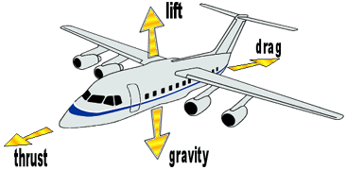
What Makes Objects Move?
In Kinematics (Unit 3) We Learned:
How Objects Move & Different Kinds Of Motion
But Not Why They Move The Way They Do

Slide 3

What Makes Objects Move?
Forces cause objects to start moving
Forces cause objects to change their velocity (e.g. speed or direction of motion)
Examples of common forces
Gravity / Electromagnetism
Mechanical forces caused by you car engine
Mechanical forces caused by you car brakes
Pushing a box
Pulling a wagon

Slide 4
Force Definitions
Forces affect the motion of objects
Force is a vector
F= force, m= mass, a= acceleration
Force is measured in Newtons (N)
F = ma
1 N = 1 Kg m / s²

Slide 5
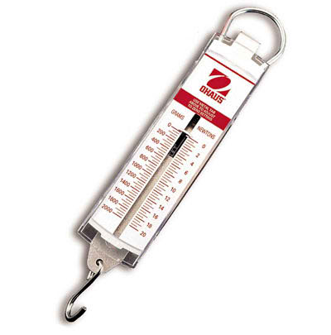
Spring Scale
Force can be measured using a spring scale.
Weight and mass are often confused with the force of gravity.
Your mass is 60 Kg
Your weight is 600 N

Slide 6

Gravity
F_{g}
The force of Gravity is written as:
One Newton is about equal to the weight of a small apple.
How can we draw an apple falling towards the ground?
FBD
a

Slide 7
Gravity
F_{g}
The force of Gravity is written as:
One Newton is about equal to the weight of a small apple.
How can we draw an apple falling towards the ground?
FBD
V
F_{g}

Slide 8
Tension
F_{T}
The Tension Force is written as:
Tension is a pulling force applied by strings or ropes.
How can we draw an apple suspended by a string?
FBD

Slide 9
Tension
F_{T}
The Tension Force is written as:
Tension is a pulling force applied by strings or ropes.
How can we draw an apple suspended by a string?
FBD
F_{T}
F_{g}

Slide 10
Normal Force
F_{N}
The Normal Force is written as:
The normal force is a reaction force.
The normal force is equal to and opposite gravity.
How can we draw an apple sitting on a desk?
FBD

Slide 11
Normal Force
F_{N}
The Normal Force is written as:
The normal force is a reaction force.
The normal force is equal to and opposite gravity.
How can we draw an apple sitting on a desk?
FBD
F_{N}
F_{g}

Slide 12

Applied Force
F_{app}
The Applied Force is written as:
The applied force is a pushing force.
How can we draw a box being pushed horizontally?
FBD

Slide 13
Applied Force
F_{app}
The Applied Force is written as:
The applied force is a pushing force.
How can we draw a box being pushed horizontally?
FBD
F_{app}

Slide 14
Friction Force
F_{f}
The Force of Friction is written as:
The force of friction is a reaction force.
It is opposite to the direction of motion.
How can we draw box being slowed to a stop by friction?
FBD
V

Slide 15
Friction Force
F_{f}
The Force of Friction is written as:
The force of friction is a reaction force.
It is opposite to the direction of motion.
How can we draw box being slowed to a stop by friction?
FBD
F_{f}
F_{app}
V

Slide 16
Net Force (F_{net})
The Net Force is the sum of all forces acting on an object
When the net force is balanced the object moves with uniform velocity (or is stationary).
When the net force is unbalanced the object moves with accelerated motion.
How can we draw all the forces acting on the box?
FBD
V

Slide 17
Net Force (F_{net})
The Net Force is the sum of all forces acting on an object
When the net force is balanced the object moves with uniform velocity (or is stationary).
When the net force is unbalanced the object moves with accelerated motion.
How can we draw all the forces acting on the box?
FBD
F_{N}
F_{f}
F_{app}
a
F_{g}

Slide 18
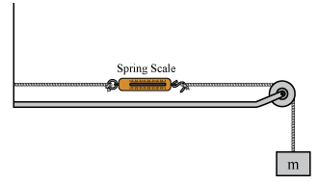

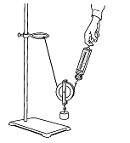
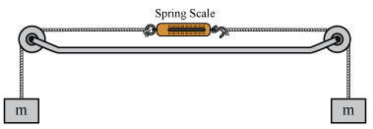
Your Turn
Complete the Force Introduction Investigation.

